Slide 1
Family
UNIT 3A

Slide 2

Agenda
Review: Jobs
The Royal family
Vocabulary: Family
Grammar: Possessive ´s
Reading: The Browns

Slide 3

Learning objectives
The student will be able to know more about the British monarchy.
The student will be able to learn the family members in different contexts.

Slide 4

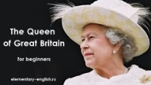
The Royal family

Slide 5
Comprehension task I
Queen
UK
The Royal family
What’s the Queen’s name?
How old is she?
Where does she live?
Who are their family members?
What does Elizabeth like?
Elizabeth II
89 years old
Buckingham palace, London.
She’s got a husband, three sons and her daughter.
She likes dogs and she has got two.

Slide 6
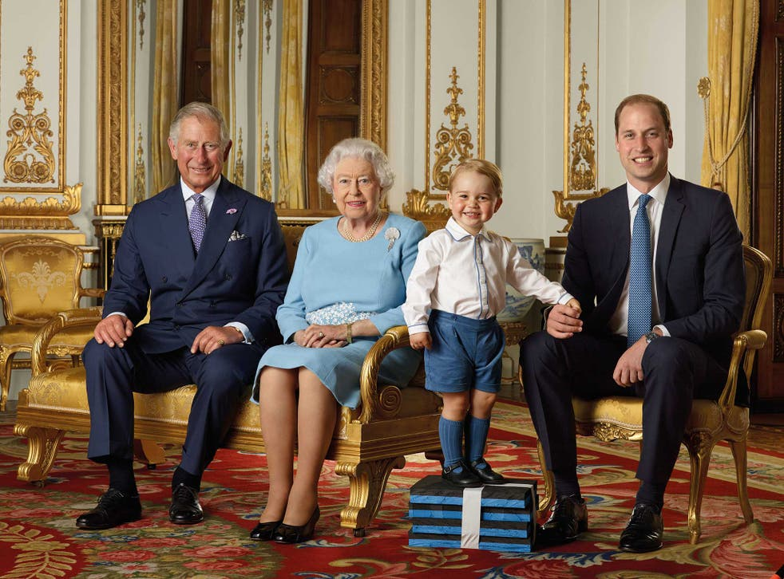
Comprehension task II
Who’s William’s Grandmother?
Who’s Elizabeth’s Great-Grandson?
Who’s Charles’s elder son?
Who’s Elizabeth’s Grandson?
Who’s William’s son?
Elizabeth
George
William
William
George

Slide 7
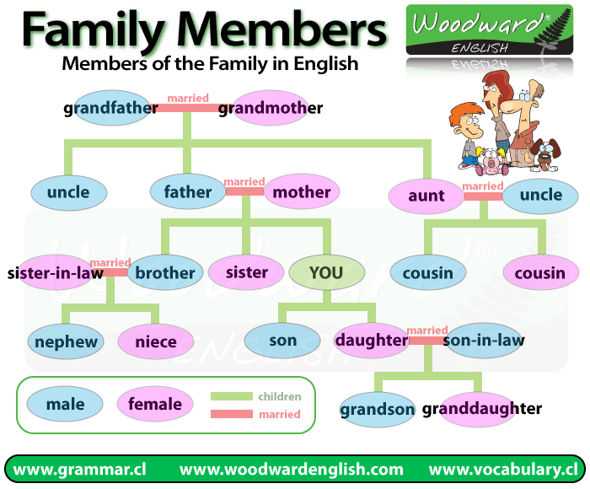
Vocabulary: Family
Your sister’s mother is your…
Your nephew’s father is your…
Your grandmother’s son is your…
Your uncle’s daughter is your…
Your aunt’s husband is your…
Mother
Brother
Father
Cousin
Uncle

Slide 8
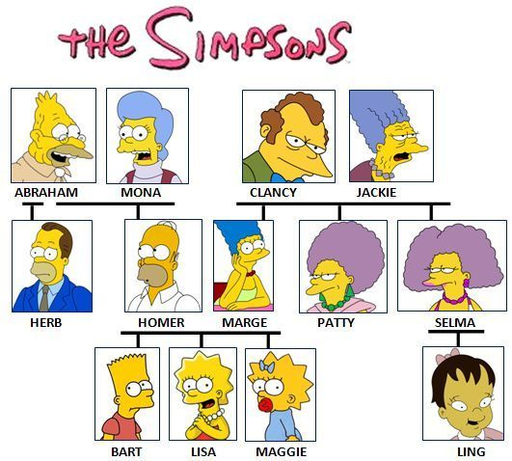
Comprehension task III
Who’s Mona’s daughter-in-law?
Who’s Ling’s mother?
Who’s Herb’s brother?
Who are Bart’s aunts?
Who are Maggie’s Grandparents?
Marge
Selma
Homer
Patty and Selma
Abraham, Mona, Clancy and Jackie.
Game ☺

Slide 9
Vocabulary: Family II
Stepmother
Godfather
Twins
Great-Grandmother
Triplets

Slide 10

Matching exercise
Godfather
Great-Grandmother
Stepmother
Triplets
Twins
Three children born to the same mother at the same time.
A male godparent.
Two children born to the same mother on the same occasion.
The grandmother of one of your parents.
The woman who is married to someone’s father but who isn’t their real mother.
Game ☺

Slide 11
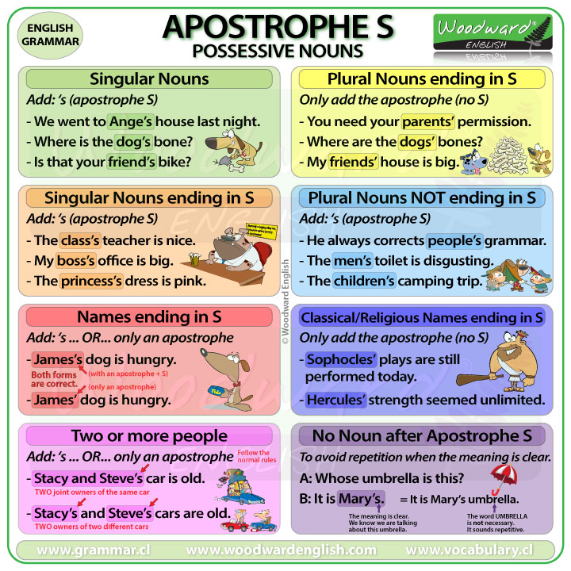
Possessive ‘s

Slide 12
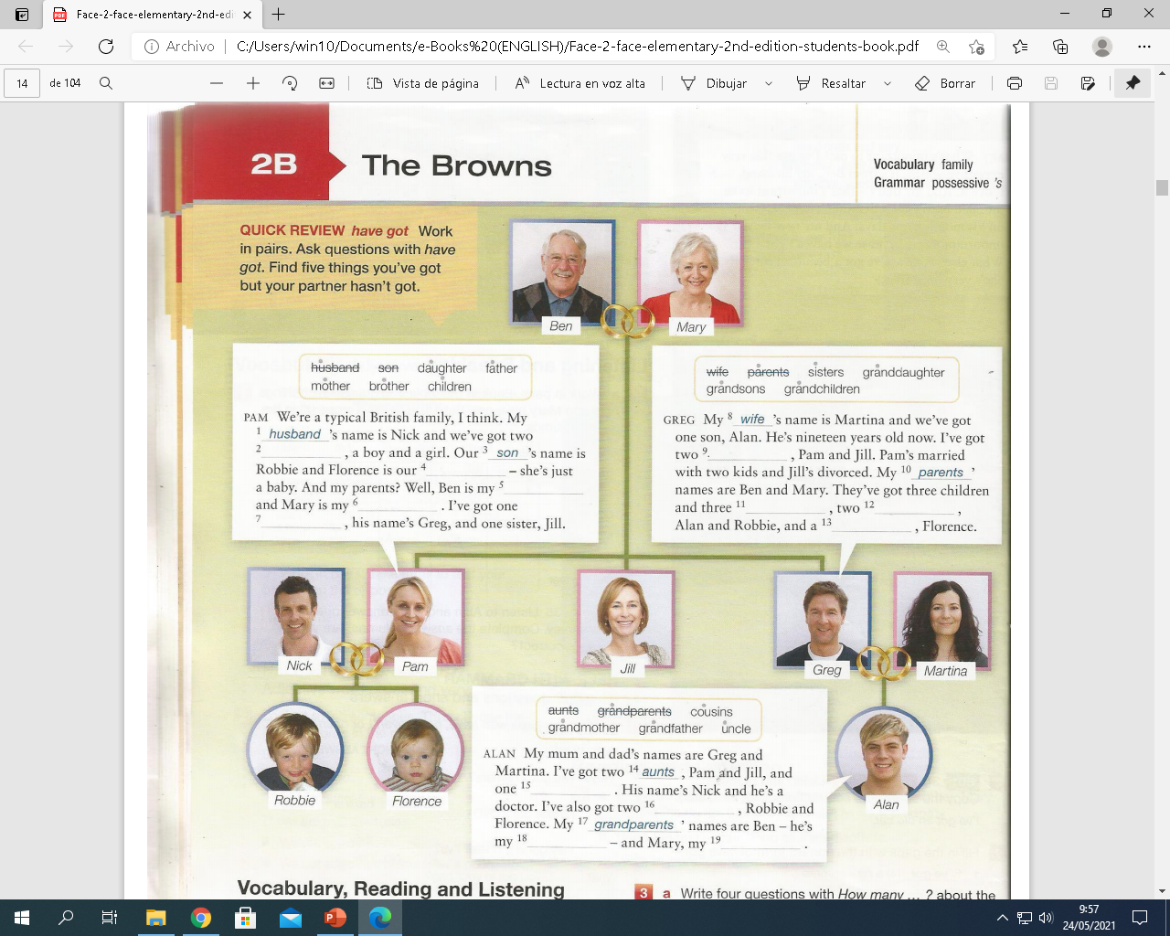

The Browns
8. Wife
9. Sisters
10. Parents
11. Grandchildren
12. Grandsons
13. Granddaughter
Husband
Children
Son
Daughter
Father
Mother
Brother
14. Aunts
15. Uncle
16. Cousins
17. Grandparents
18. Grandfather
19. Grandmother
Redston, C., & Cunningham, G. (2019). face2face Elementary Student's Book, UNIT 2B The Browns. In face2face Elementary Student's Book (2nd ed., pp. 18–19). essay, Cambridge University Press.

Slide 13
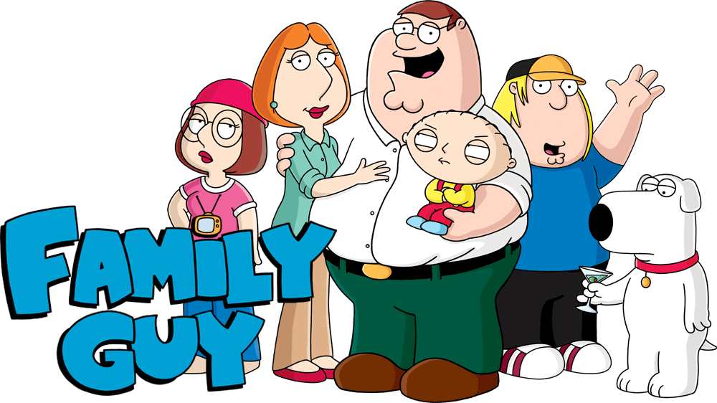
My family
How many brothers and sisters have you got?
How old are your parents?
What are their names?
Who’s your favorite member of the family?
How often do you visit your relatives?

Slide 14
Tongue twister
Father, mother, sister and brother hand in hand with one another.

Slide 15
Vocabulary
Speaking
Vocabulary builder
Cake
English tips

Slide 16
